Slide 1
Chapter 14
Multicasting
And
Multicast
Routing Protocols

Slide 2
CONTENTS
INTRODUCTION
MULTICAST ROUTING
MULTICAST TREES
MULTICAST ROUTING PROTOCOLS
DVMRP
MOSPF
CBT
PIM
MBONE

Slide 3
14.1
INTRODUCTION

Slide 4
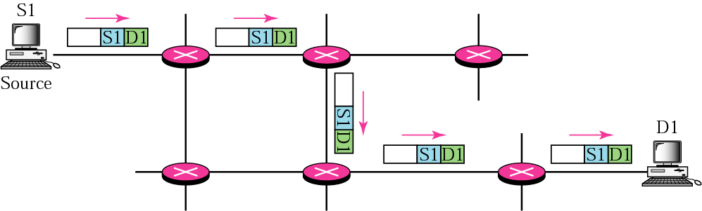
Figure 14-1
Unicasting

Slide 5

In unicast routing, the router forwards
the received packet through
only one of its interfaces.

Slide 6
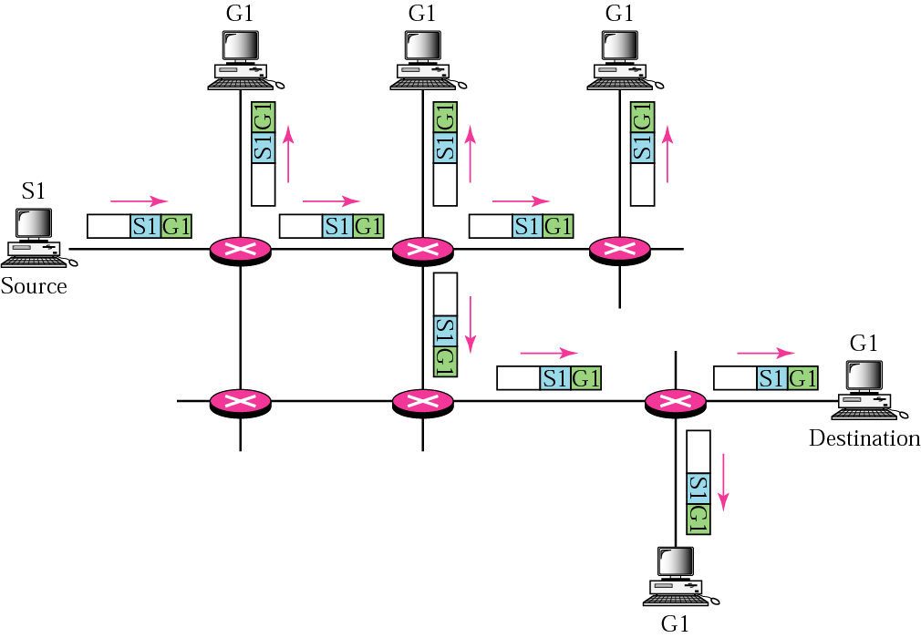
Figure 14-2
Multicasting

Slide 7
In multicast routing,
the router may forward the
received packet
through several of its interfaces.

Slide 8
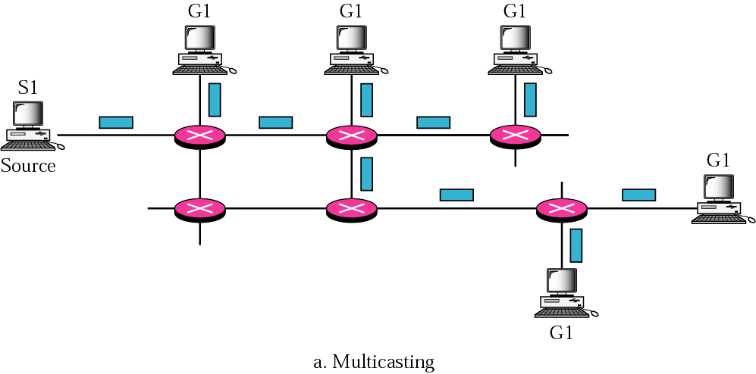
Figure 14-3:a
Multicasting versus multiple unicasting

Slide 9
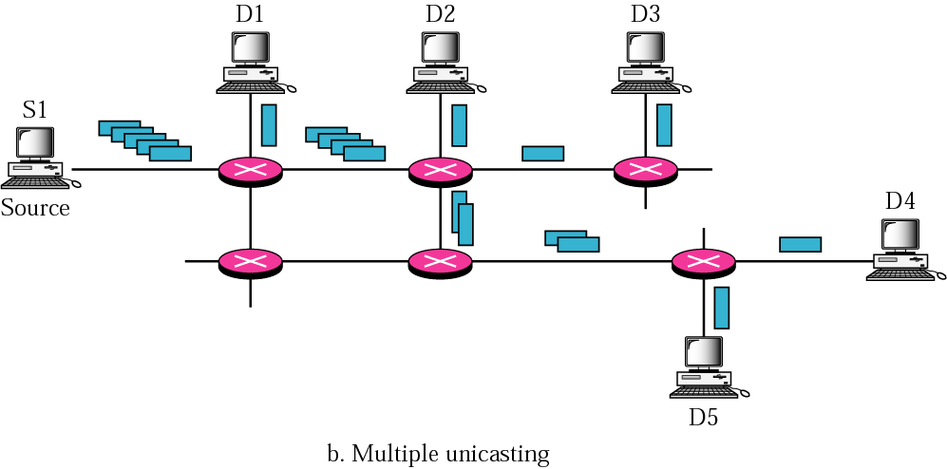
Figure 14-3:b
Multicasting versus multiple unicasting

Slide 10
Emulation of multicasting through
multiple unicasting is not
efficient and may
create long delays,
particularly with a large group.

Slide 11
14.2
MULTICAST
ROUTING

Slide 12
14.3
MULTICAST
TREES

Slide 13
In a source-based tree approach,
the combination of source
and group determines the tree.

Slide 14
In the group-shared tree approach,
the group determines the tree.

Slide 15
14.4
MULTICAST
ROUTING
PROTOCOLS

Slide 16
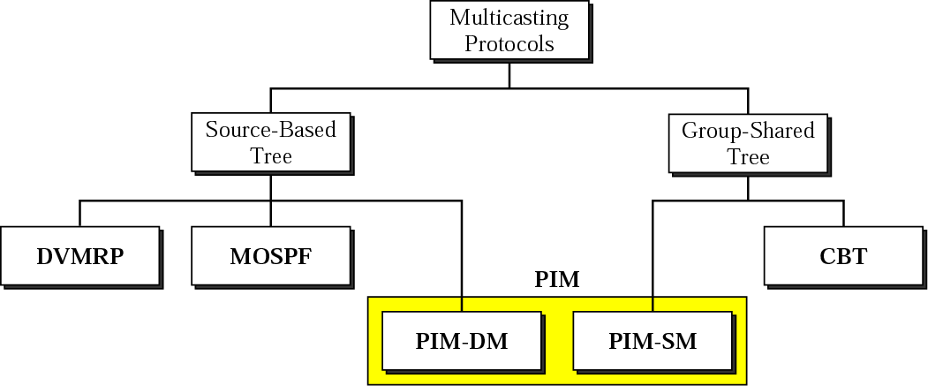
Figure 14-4
Multicast routing protocols

Slide 17
14.5
DVMRP

Slide 18
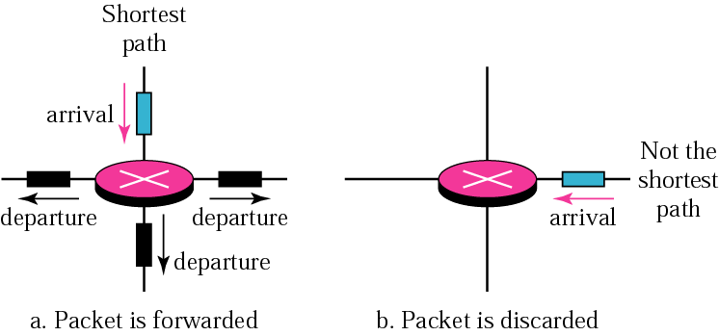
Figure 14-5
Reverse path forwarding

Slide 19
In reverse path forwarding (RPF),
the router forwards only
the packets that have traveled the
shortest path from the source
to the router; all other
copies are discarded.

Slide 20
RPF prevents
the formation of loops.

Slide 21
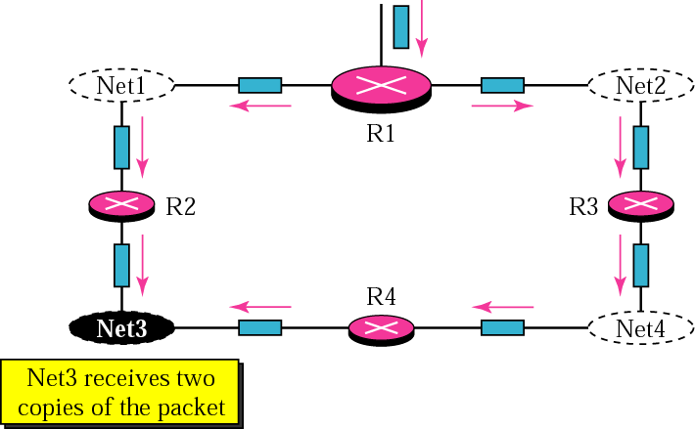
Figure 14-6
Reverse path broadcasting

Slide 22
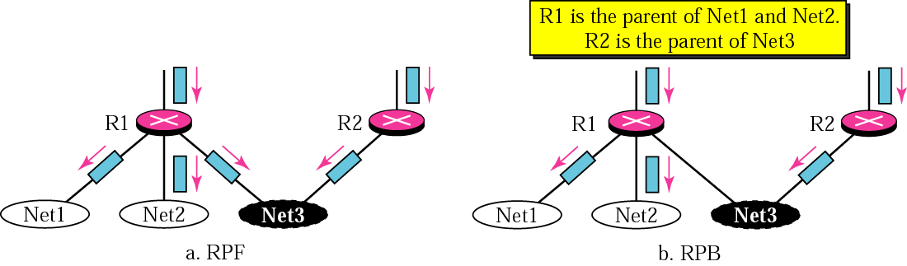
Figure 14-7
RPF versus RPB

Slide 23
RPB creates a shortest path
broadcast tree from the source
to each destination.
It guarantees that each destination
receives one and only
one copy of the packet.

Slide 24
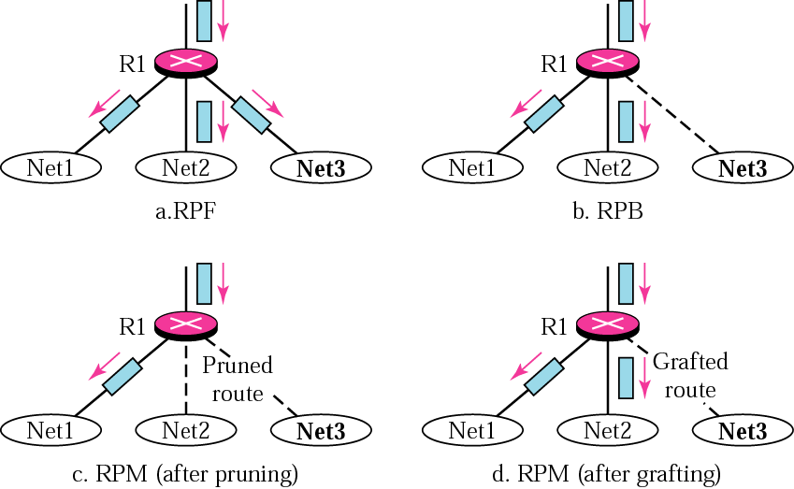
Figure 14-8
RPF, RPB, and RPM

Slide 25
RPM adds pruning and grafting to RPB
to create a multicast shortest
path tree that supports
dynamic membership changes.

Slide 26
14.6
MOSPF

Slide 27
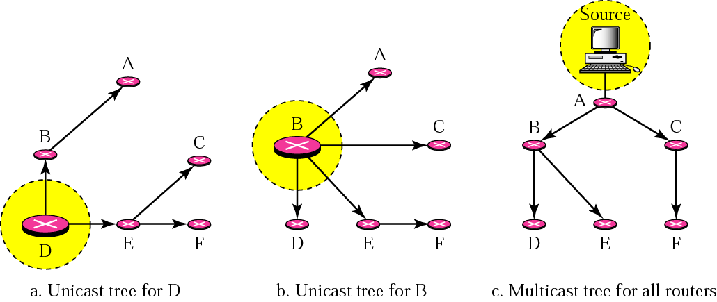
Figure 14-9
Unicast tree and multicast tree

Slide 28
14.7
CBT

Slide 29
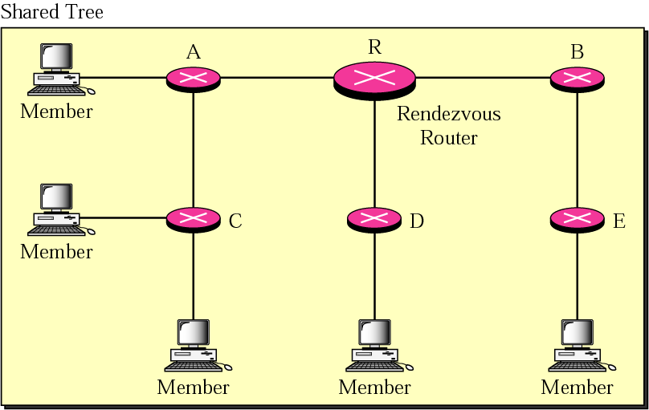
Figure 14-10
Shared-group tree with rendezvous router

Slide 30
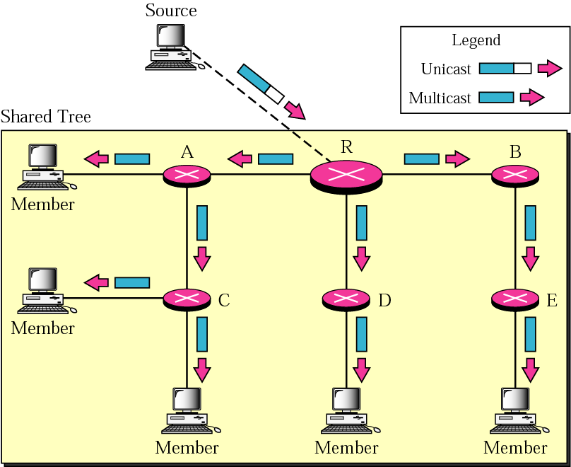
Figure 14-11
Sending a multicast packet to
the rendezvous router

Slide 31
In CBT, the source sends the
multicast packet (encapsulated in a
unicast packet) to the core router.
The core router decapsulates the
packet and forwards it
to all interested hosts.

Slide 32
14.8
PIM

Slide 33
PIM-DM is used in a
dense multicast environment,
such as a LAN environment.

Slide 34
PIM-DM uses RPF and pruning/grafting
strategies to handle multicasting.
However, it is independent from
the underlying unicast protocol.

Slide 35
PIM-SM is used in a sparse multicast
environment such as a WAN.

Slide 36
PIM-SM is similar to CBT
but uses a simpler procedure.

Slide 37
14.9
MBONE

Slide 38
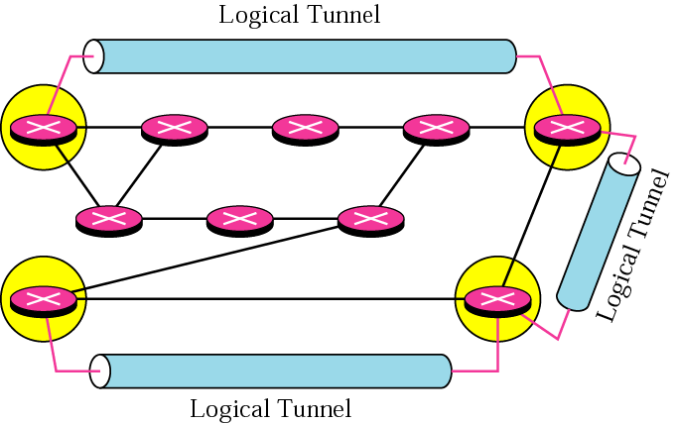
Figure 14-12
Logical tunneling

Slide 39
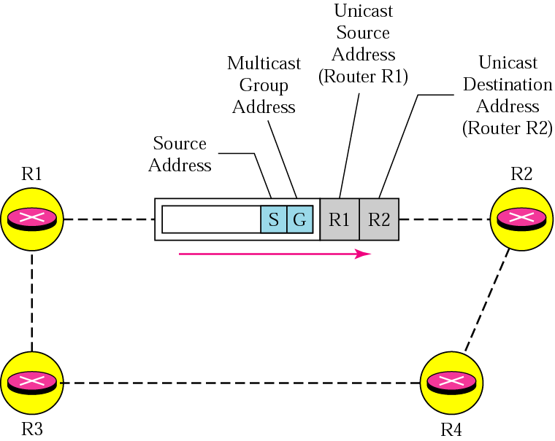
Figure 14-13
MBONE

Slide 40
DVMRP supports MBONE

